Slide 1

Week 1

Slide 2
lesson 1

Slide 3

classroom expectations

Slide 4
assessment

Slide 5
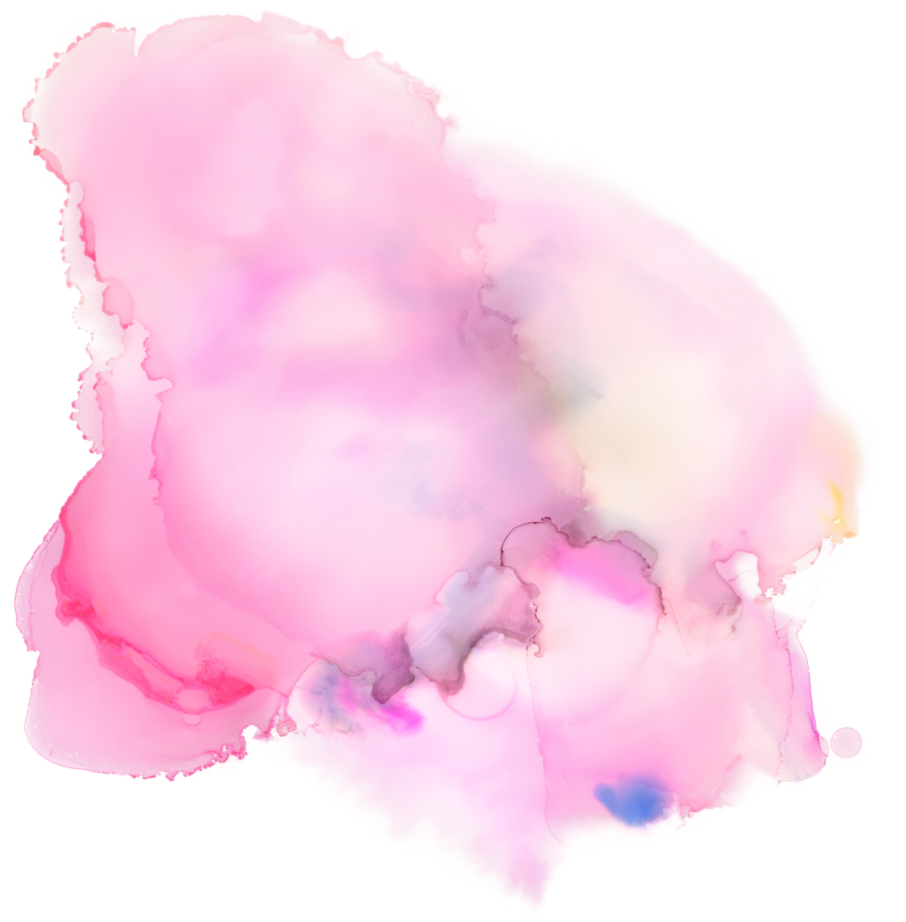
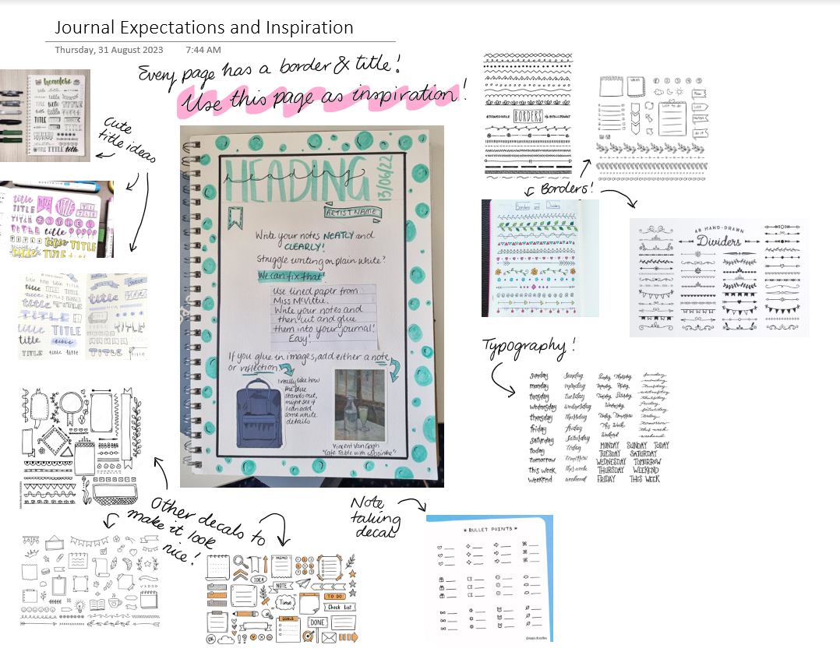
journal expectations

Slide 6


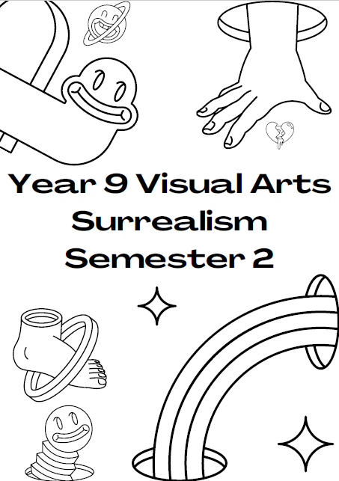
title page
glue in and colour in!
OR
create your own!

Slide 7
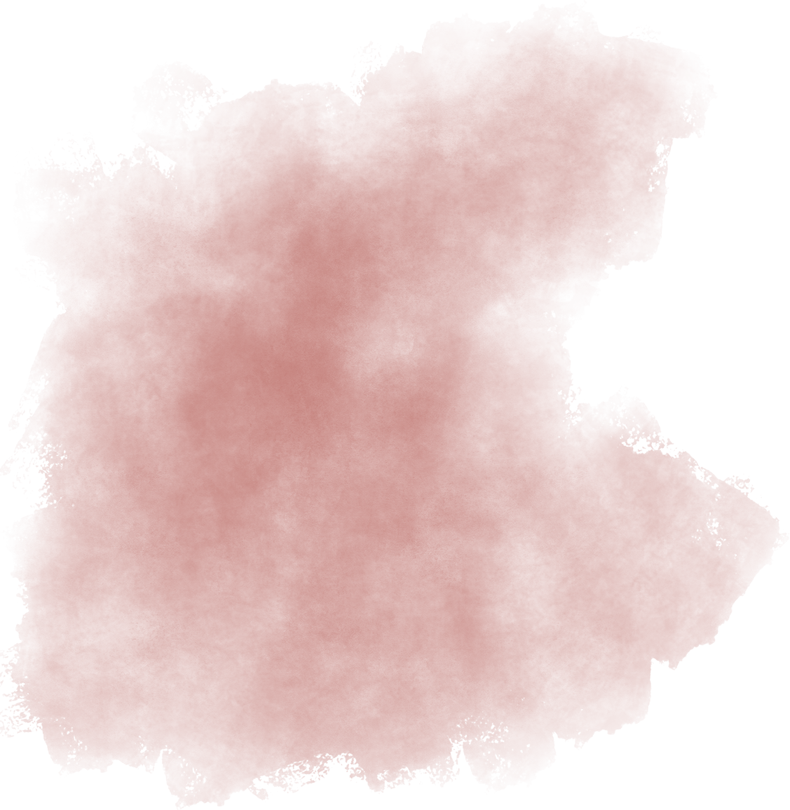
the elements of art
line
shape
tone/value
texture
colour

Slide 8
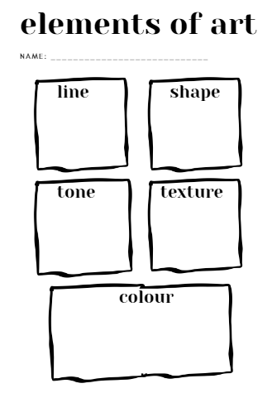
the elements of art
worksheet

Slide 9

line
A MARK THAT HAS A BEGINNING AND AN END.
LINES CAN BE SHORT, LONG, CURVY OR BLOCKY.

Slide 10



shape
THERE ARE THREE TYPES OF SHAPE.
ORGANIC
GEOMETRIC
ANGULAR

Slide 11
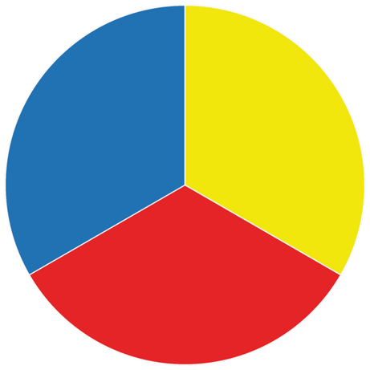
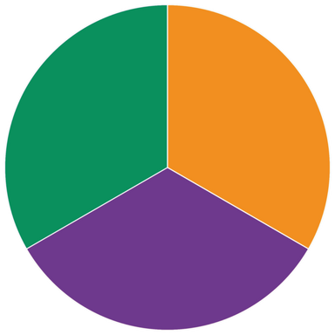
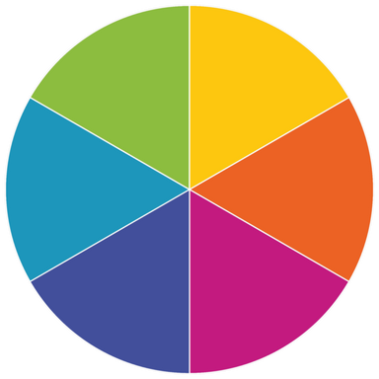
colour
PRIMARY COLOURS (CANNOT BE MIXED)
SECONDARY COLOURS (MIX OF TWO PRIMARY COLOURS)
TERTIARY COLOURS (MIX OF A PRIMARY AND SECONDARY COLOUR)

Slide 12
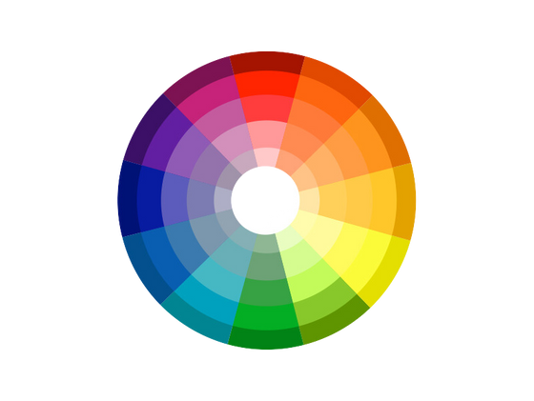

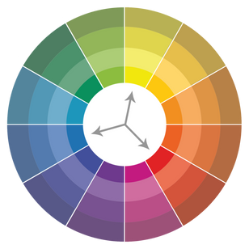

colour
MONOCHROMATIC: ONE COLOUR IN VARIED TONE.
ANALOGOUS: THREE COLOURS TOGETHER ON THE COLOUR WHEEL.
TRIADIC: COLOURS LINKED BY A TRIANGLE ON THE COLOUR WHEEL.
COMPLEMENTARY: COLOURS OPPOSITE EACH OTHER ON THE COLOUR WHEEL

Slide 13
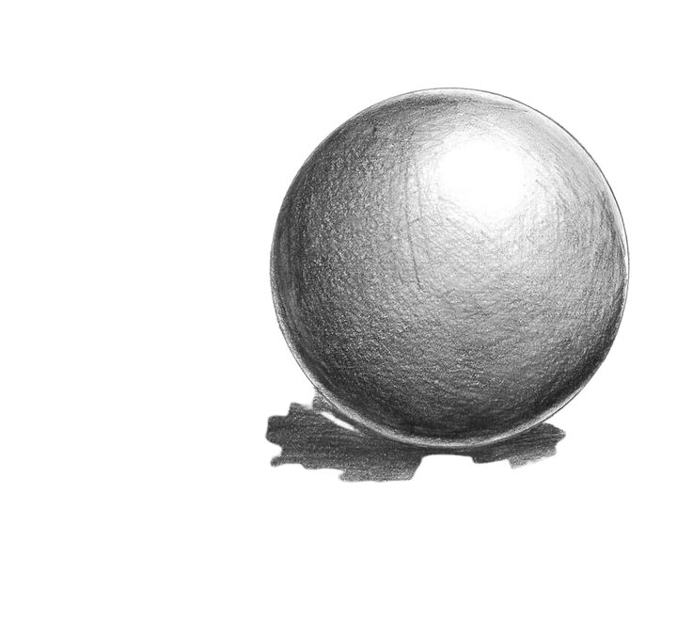
tone/value
DEGREES FROM LIGHT TO DARK TO CREATE FORM (3D)

Slide 14
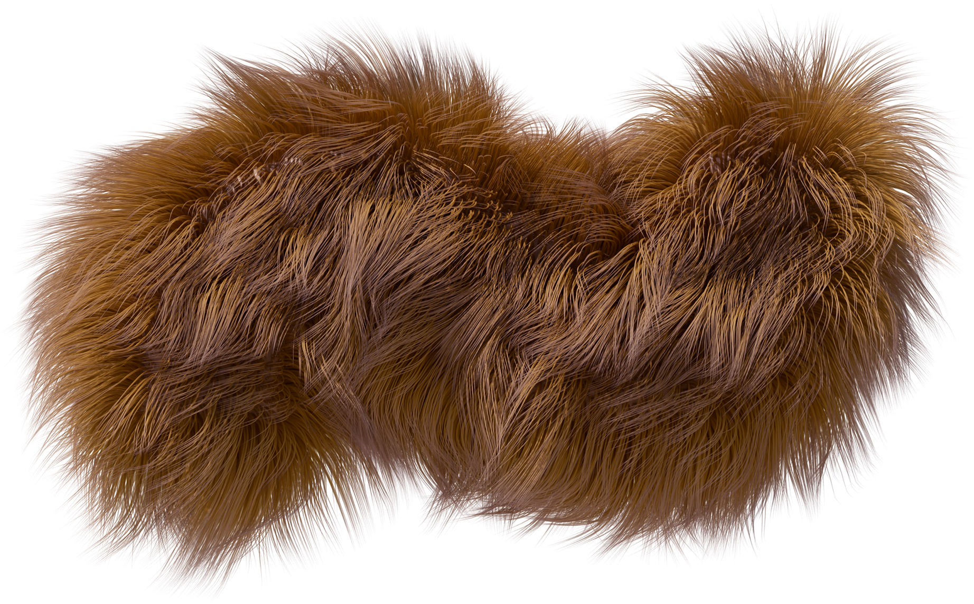

texture
THERE ARE TWO TYPES OF TEXTURE:
ACTUAL (VISUAL): YOU SEE HOW IT FEELS.
TACTILE: YOU NEED TO TOUCH TO KNOW HOW IT FEELS

