Slide 1




Australiana Collage
Australiana Collage

Slide 2
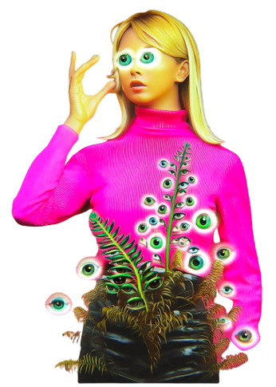
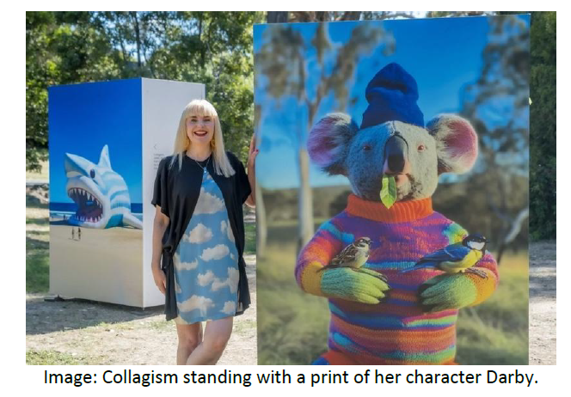
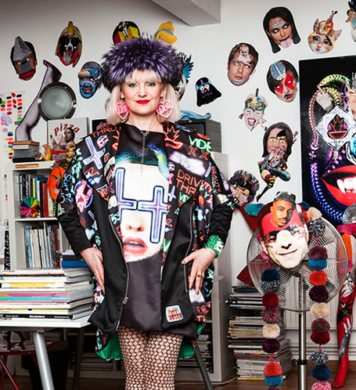
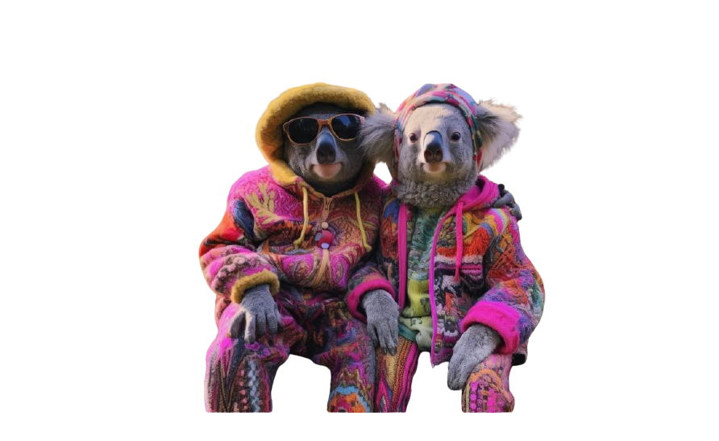
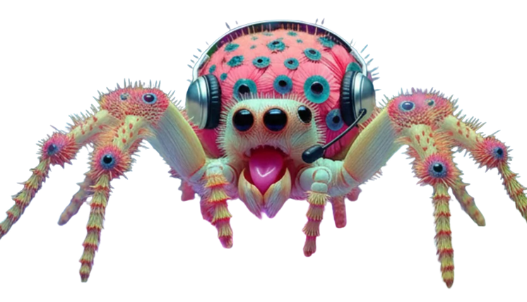

Slide 3
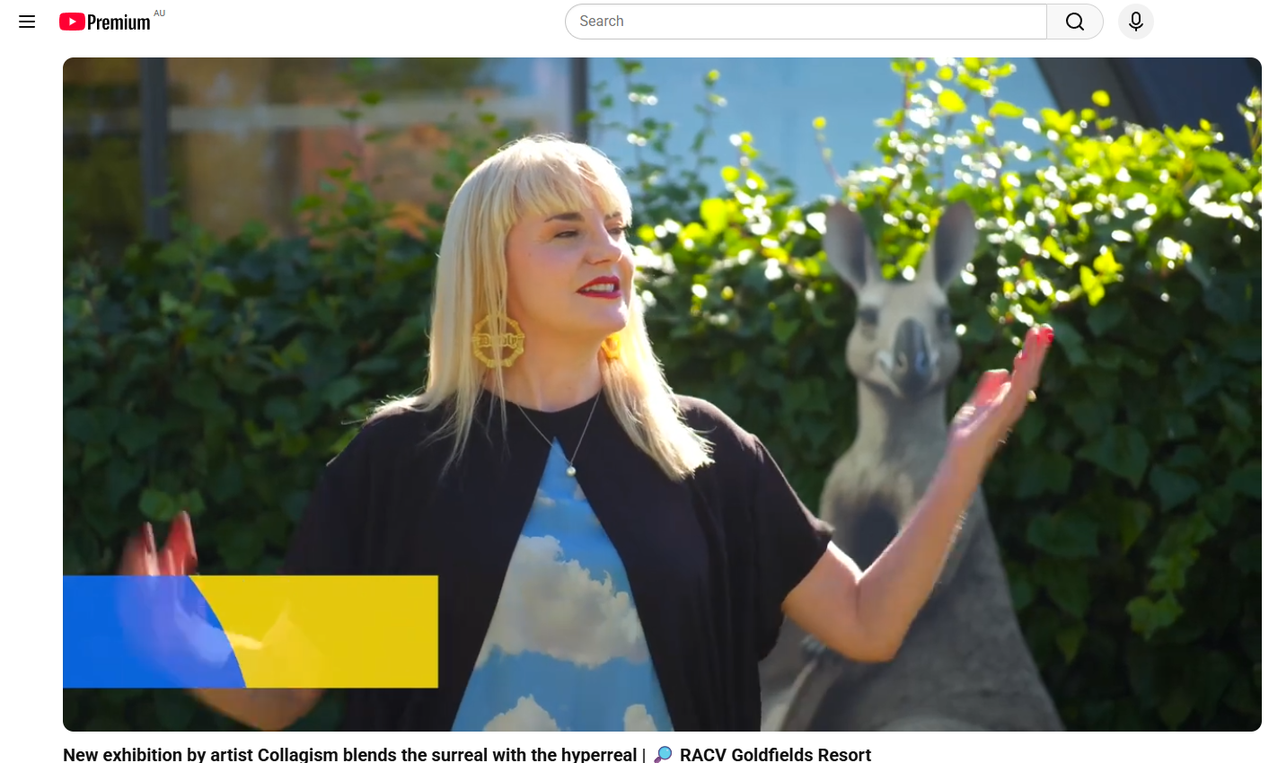
https://www.youtube.com/watch?v=ZYH3tF2fhWg

Slide 4
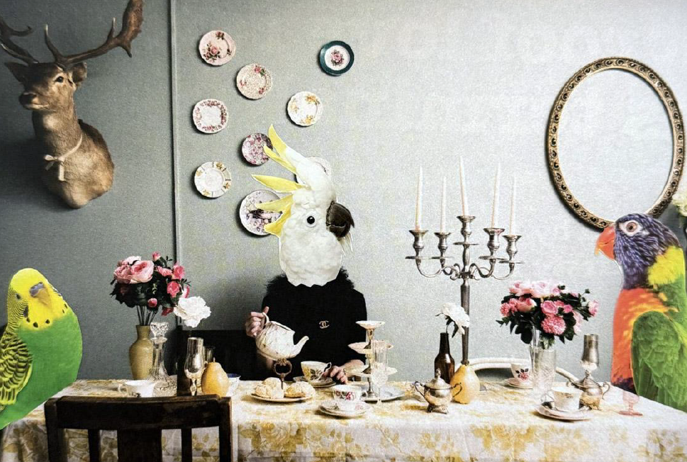

Slide 5
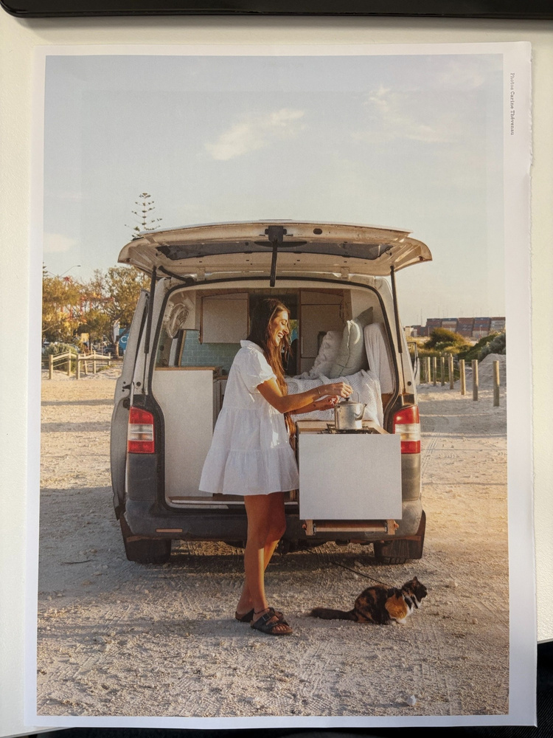
Step 1:
Flip through magazines and find a photographic scene with a person, or people in it.
Note: Try to avoid text.

Slide 6
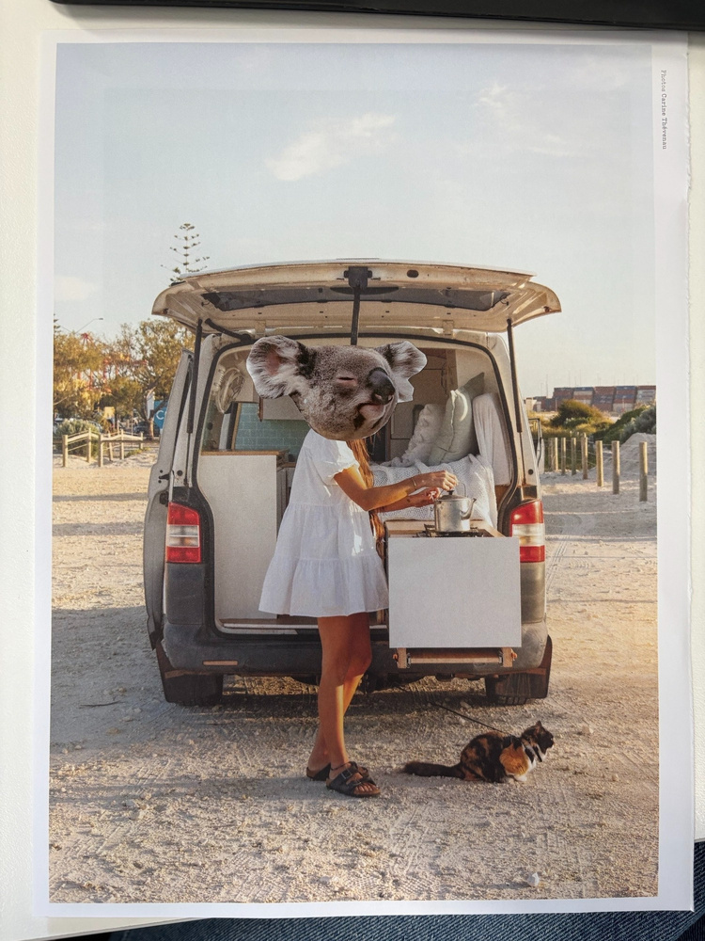
Step 2:
From your animal reference sheet, cut the animal heads to cover the heads of the humans in the picture.

Slide 7
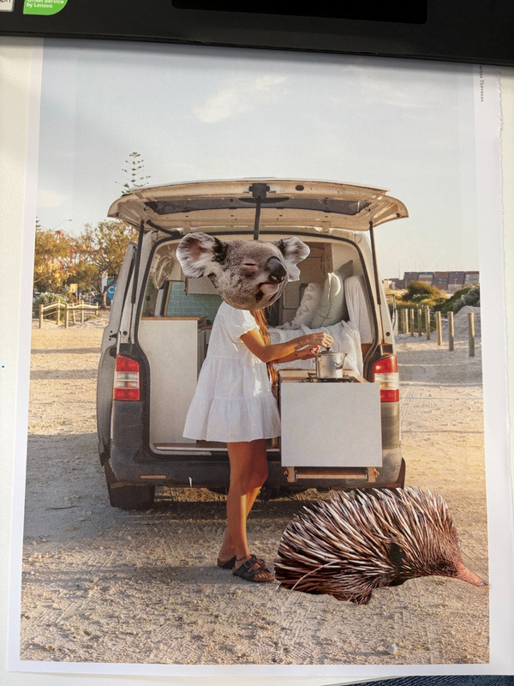
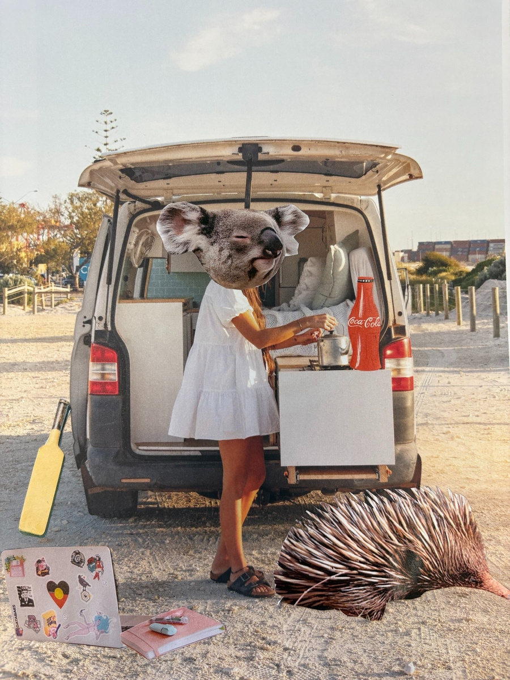
Step 3:
Add another animal or two into the scene to look like they belong there.
Cut out some objects from magazines to add to your scene.

Slide 8
Step 4:
Document on Miss McVittie’s Ipad

