Slide 1

Pop Art Australian Art Mash-Up

Slide 2

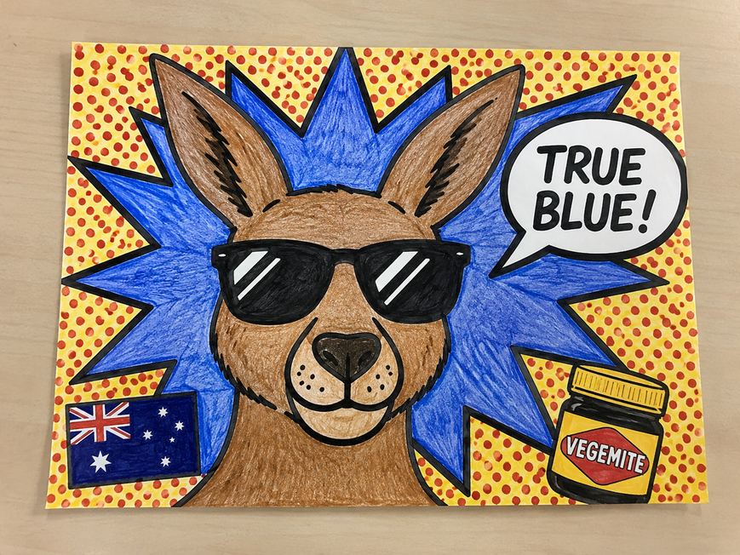
Task 1:
Create a Pop Art Poster using an Australian symbol and turn it into a Pop Artwork.
Your work must include:
  Bold black lines
  Bright colours (triadic is best)
  Patterns
  An Aussie slogan
  Benday Dots

Slide 3
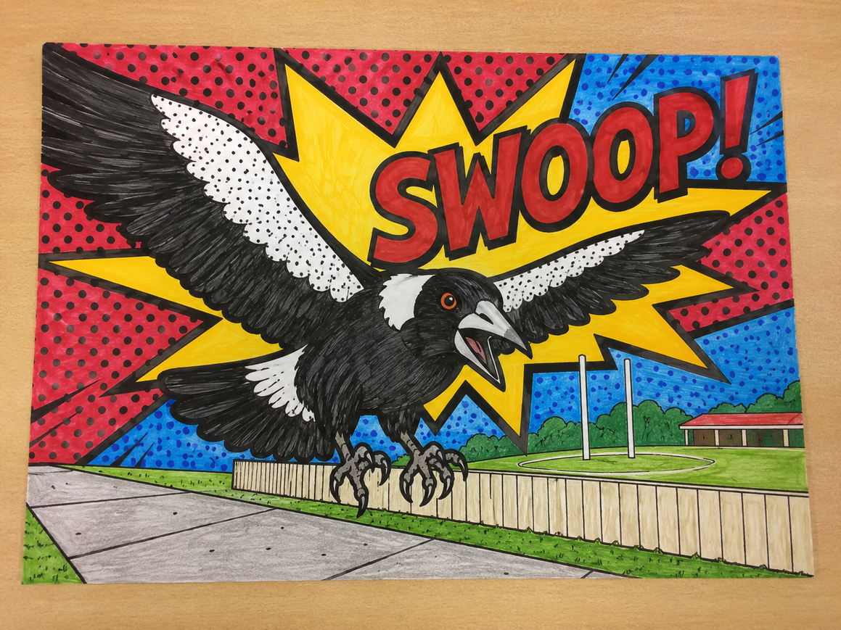
Task 1:
You can use:
  Coloured Pencil
  Texta
  Paint
  Use Black Pen to outline!

Slide 4
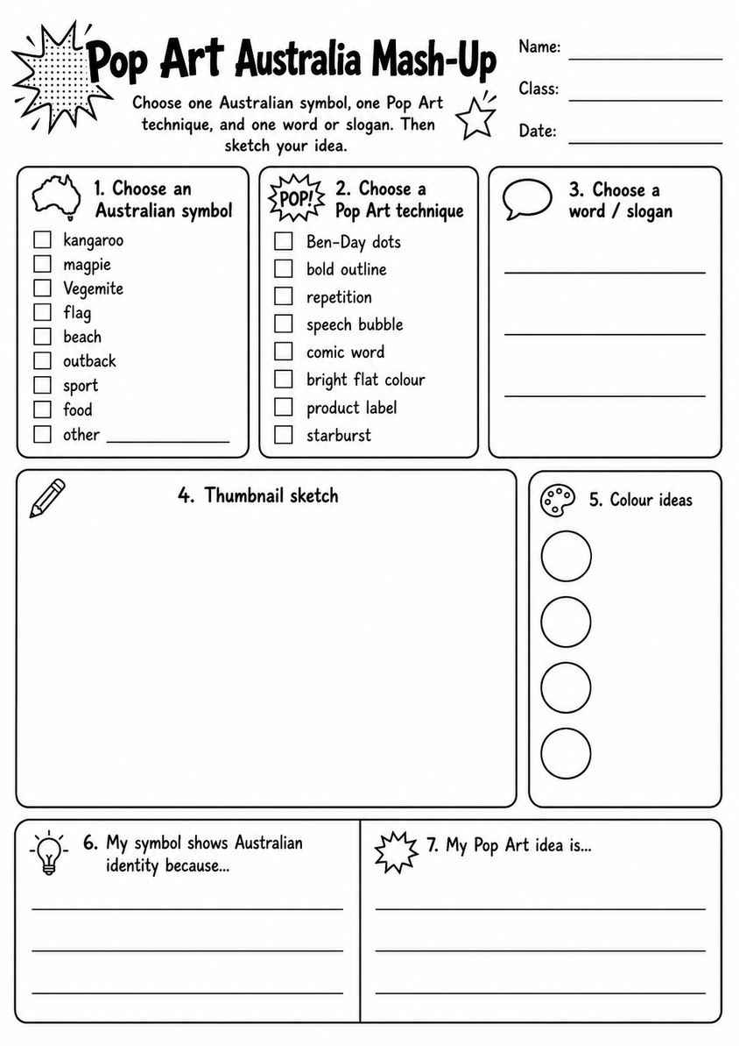
Plan
Glue into your Journal once completed.

Slide 5





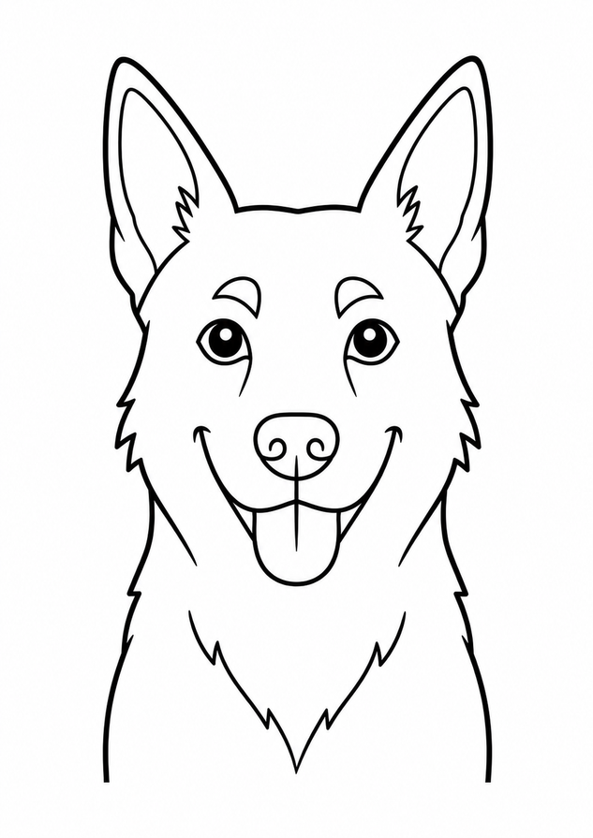
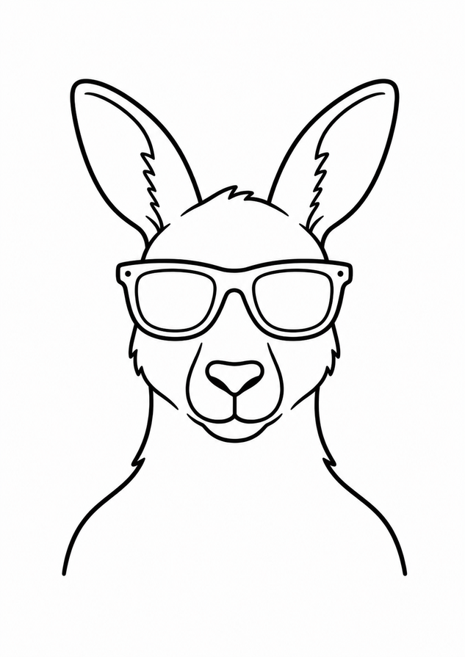
Templates

Slide 6
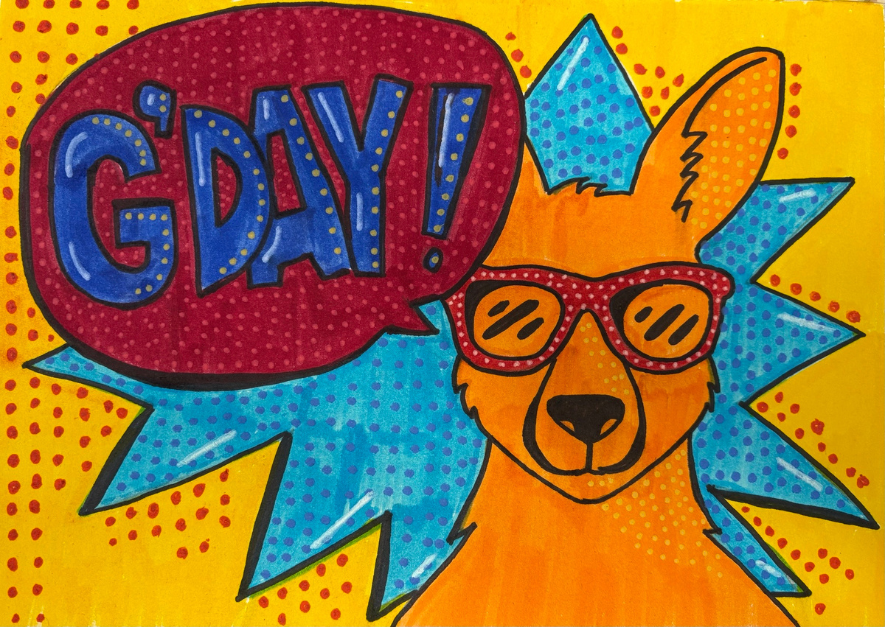
Complete

Slide 7
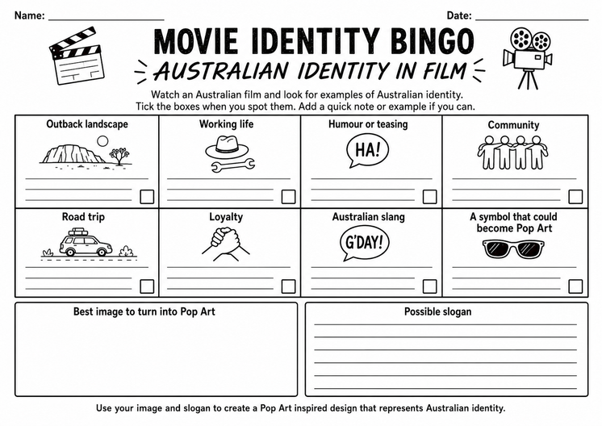
Task 2:
We are going to watch “Red Dog” and you are going to complete the BINGO activity.
Some of you can be finishing your work from last week also!

Slide 8

This worksheet will guide our final product
Glue into your Journal once completed.

Slide 9
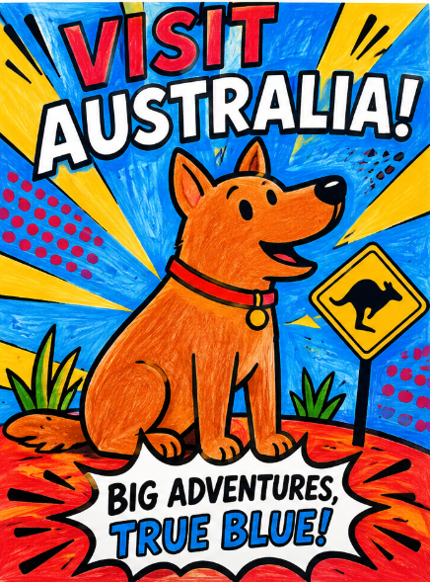
Task 3:
Based on the movie “Red Dog” you will create an advertisement poster, using a symbol and a slogan to promote visiting Australia.
You cannot use your poster from last week, but you can use 1 element you liked most.

Slide 10
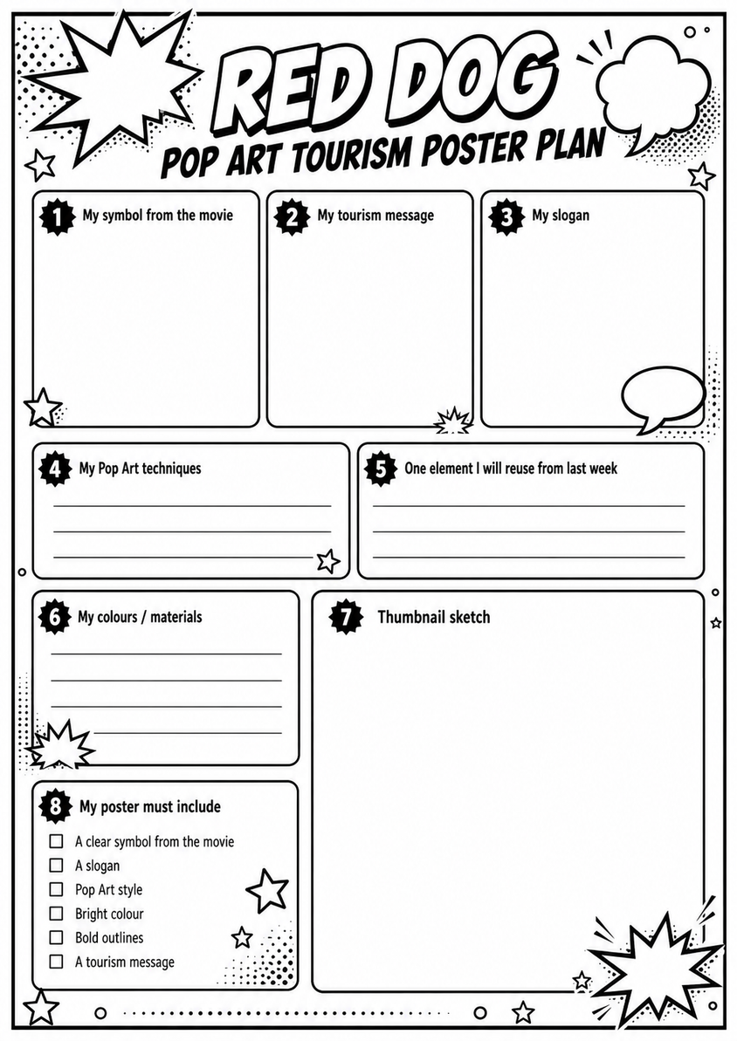
Plan:

